Slide 1

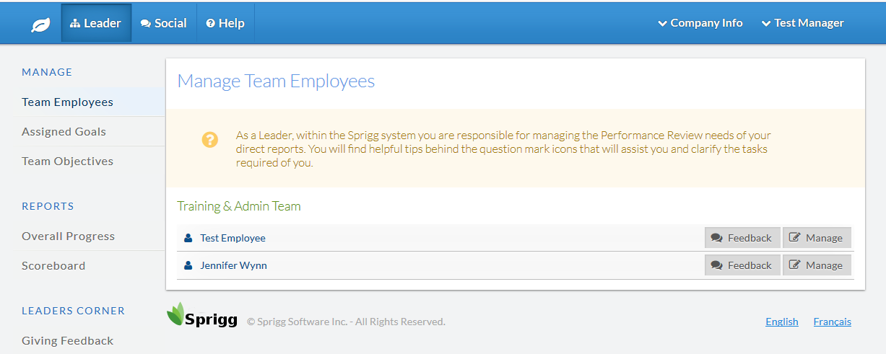
Goals – Create and Assign
Staff goals for those you manage are accessed by selecting “Leader” and then “Assigned Goals” shown to the left .

Slide 2
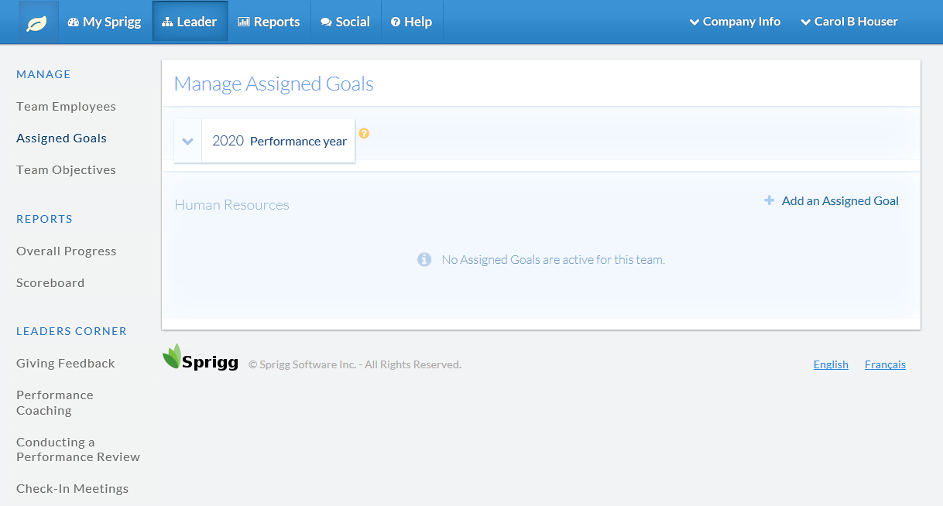
Goals – Create and Assign
Step 1
Step 2
Step 3
Step 1 - Select assigned goals on the left menu
Step 2 – Select appropriate performance year
Step 3 – Select add an assigned goal
Step 4 – Add the components of the goal (view on next slide)

Slide 3
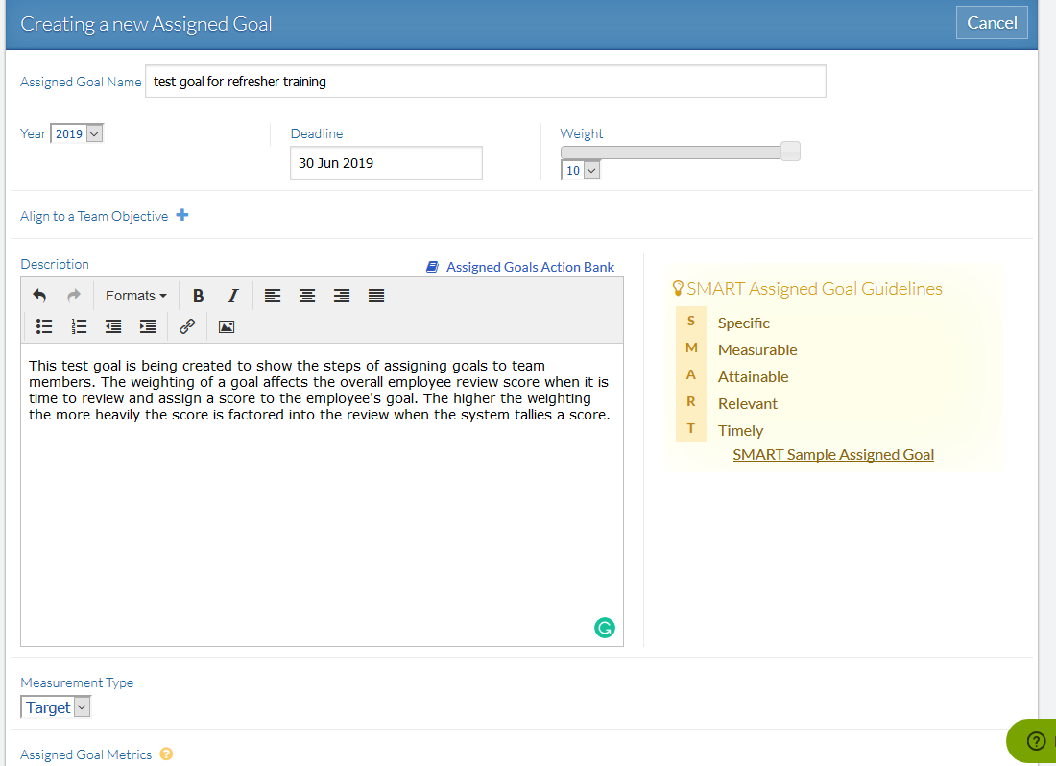
Goals – Create and Assign
Step 4
Components required for an assigned goal
Goal Name – describes what the goal is
Goal FY – the year the goal is applied
Deadline – date the goal is to be completed
Weight – calculates how heavily this goal will be considered towards the final score
Description – description of actions
Measurement type – metric, target, quota, key result, fee, $, or % driven

Slide 4
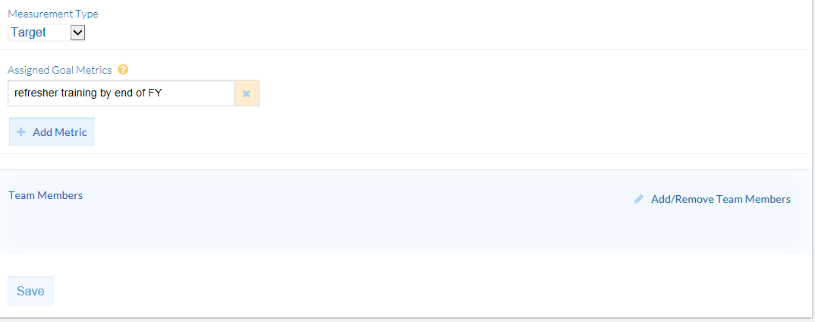
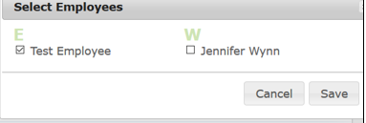
Goals – Create and Assign
Components required for an assigned goal
Metrics – description of measurement type
ADD/REMOVE Team member - you have to add/remove team members for the goal to be assigned to an individual or team and Save
SAVE – Last step to assign the goal
Step 4 - continued
Tip: The goal created may be assigned to a team or one employee. You simply select the employees (team) or employee of a team to assign the goal.
Caution: You need to Add/Remove Team Members before saving here to assign.

Slide 5
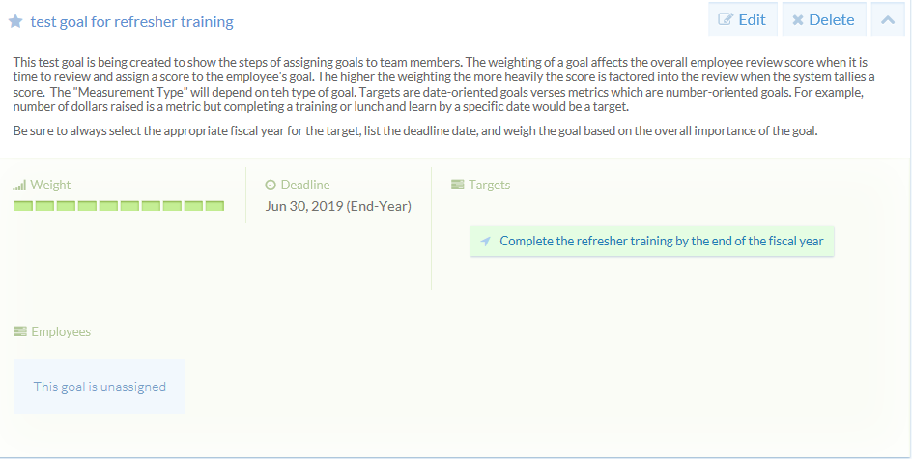
Goals – Create and Assign
If you miss assigning the goal, the status will show as unassigned.
To Add Team or Individual Members, select Edit and follow steps to add. Or, delete to remove the assigned goal.

Slide 6
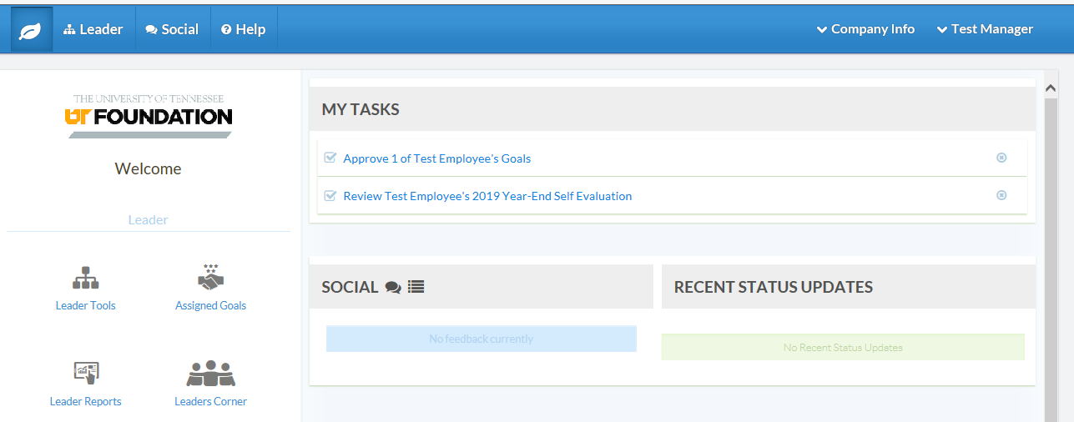
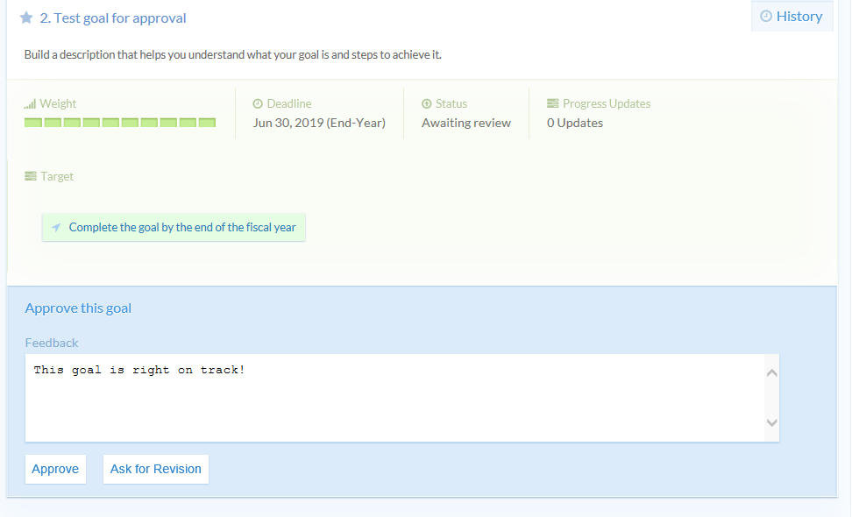
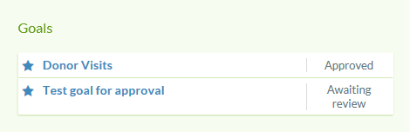
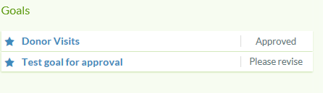
Goals – Approve/Edit and View
Goals pending approval may be viewed from the leader home page under “My Tasks”. They may also be accessed when you “Manage” an employee on their overview page.
Step 1
Step 1 - Select the goal awaiting review
Step 2 - Provide feedback
Step 3 – Approve the goal or, ask for a revision
Step 2
Tip: Revision requests will show as “Please Revise” on the overview page of the staff.
Step 3

Slide 7
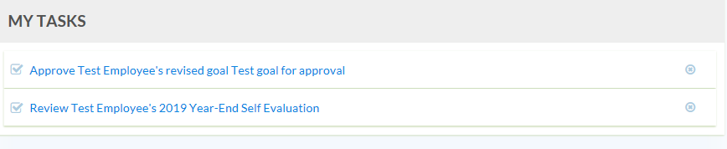
Goals – Approve/Edit and View
From the Leader view, revision requests will show as “Please Revise” on the overview page of the staff.
Once the staff member has revised the goal and resubmitted, the Leader will see the revision for approval from the “My Tasks” section on their home page.

Slide 8
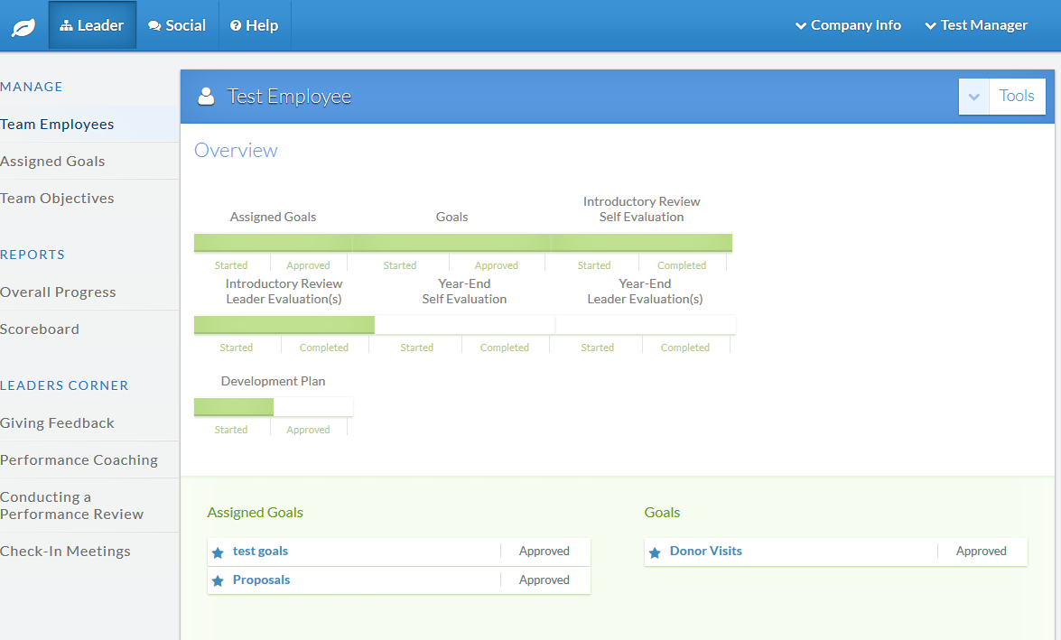
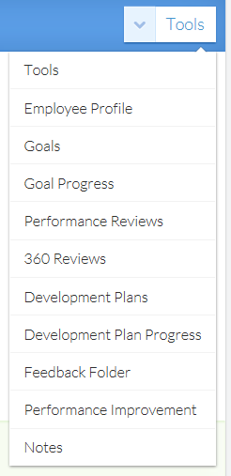
Goals – View
Goals created by the staff may be viewed from the dropdown menu when you “Manage” an employee.
From the “Leader” tab, assigned goals may be viewed by selecting “Assigned Goals” on the left menu.
Tip: The screen view shown can be achieved once you have selected “Manage” for an employee.

