Slide 1

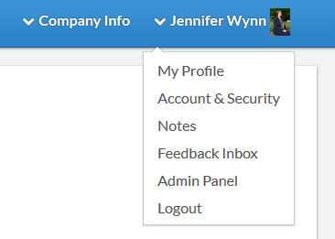
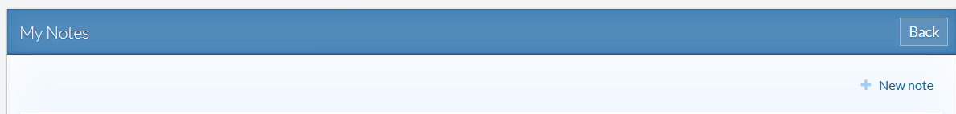
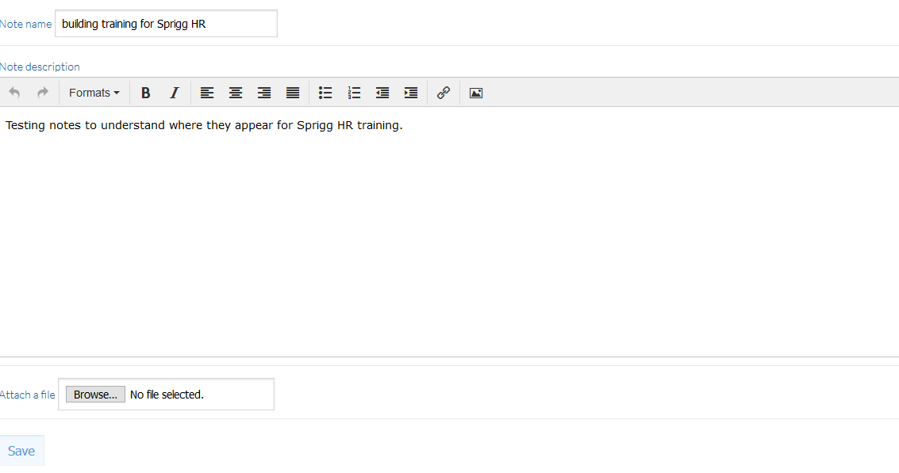
Notes – Create and View
Select “Notes” from the dropdown box under your profile to document your achievements or obstacles through the review year.
As shown to the right, select “+ New note” and create the note.
Title each note so it’s easy to determine what the note is in reference to when viewed during your review.
Select “Save” when you’ve finished creating your note.
Notes can be deleted or updated at any time through the year.

Slide 2
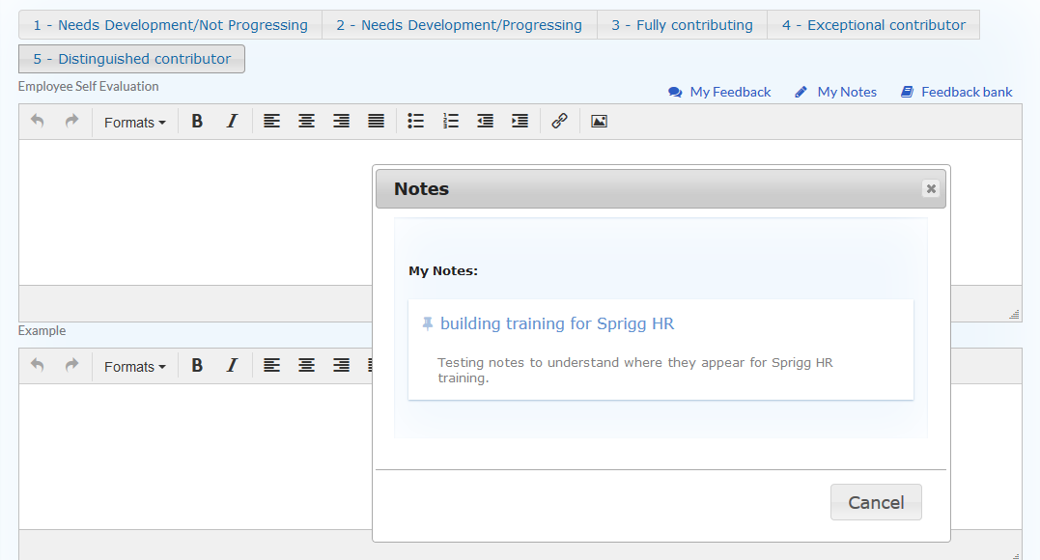
Notes – Create and View
Notes may be viewed in a pop-up box when you select “My Notes” during the self evaluation.
If not completing a self evaluations, you may view notes by selecting “Notes” in the dropdown under your name at the top of the Sprigg HR navigation bar.

